Slide 1
Final Project Skyview Swiper App
By: Thomas Hoerger – Solo Group 9

Slide 2
Step 1 Setup VPS and MySQL Database
• Deployed Ubuntu server on Google Cloud VPS.
• Installed Apache, PHP, and MySQL.

Slide 3
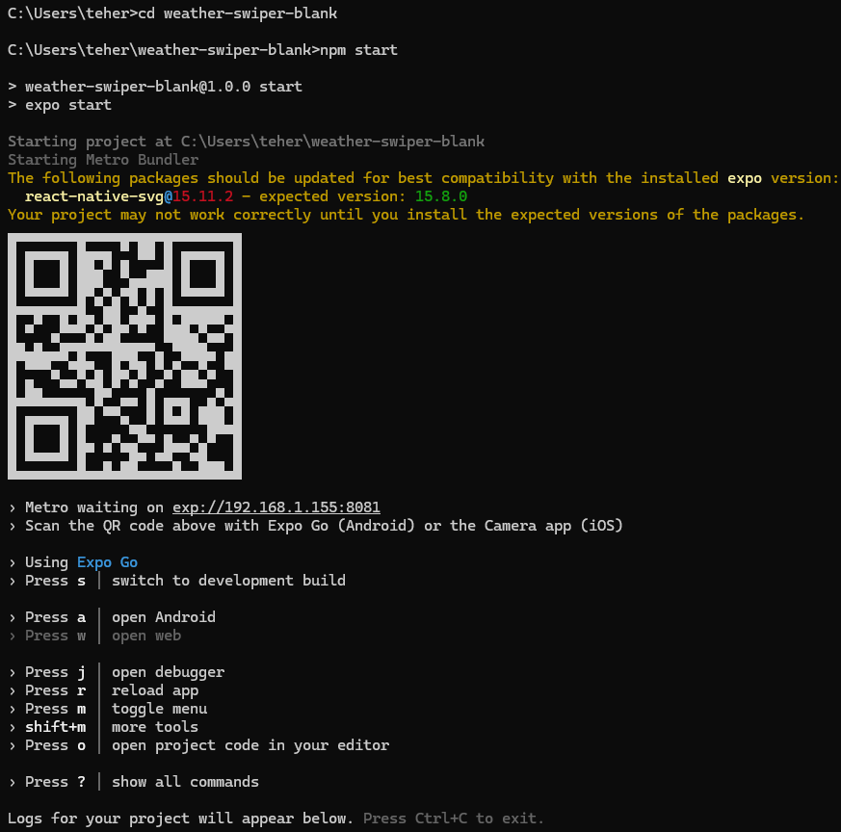
Step 2 Created Expo project with npx create-expo-app weather-swiper-blank after installing it on the local system

Slide 4
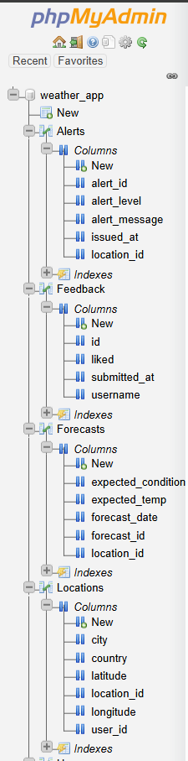
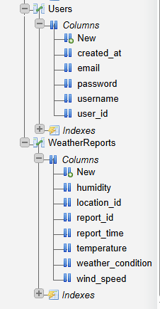
Step 3 Created a MySQL database weather_app with 6 tables: Users, Locations, WeatherReports, Forecasts, Alerts, and Feedback.

Slide 5
Step 4 Created and enabled remote access to the following PHP scripts on VPS (I edited the code comments to be under <?php) :

Slide 6
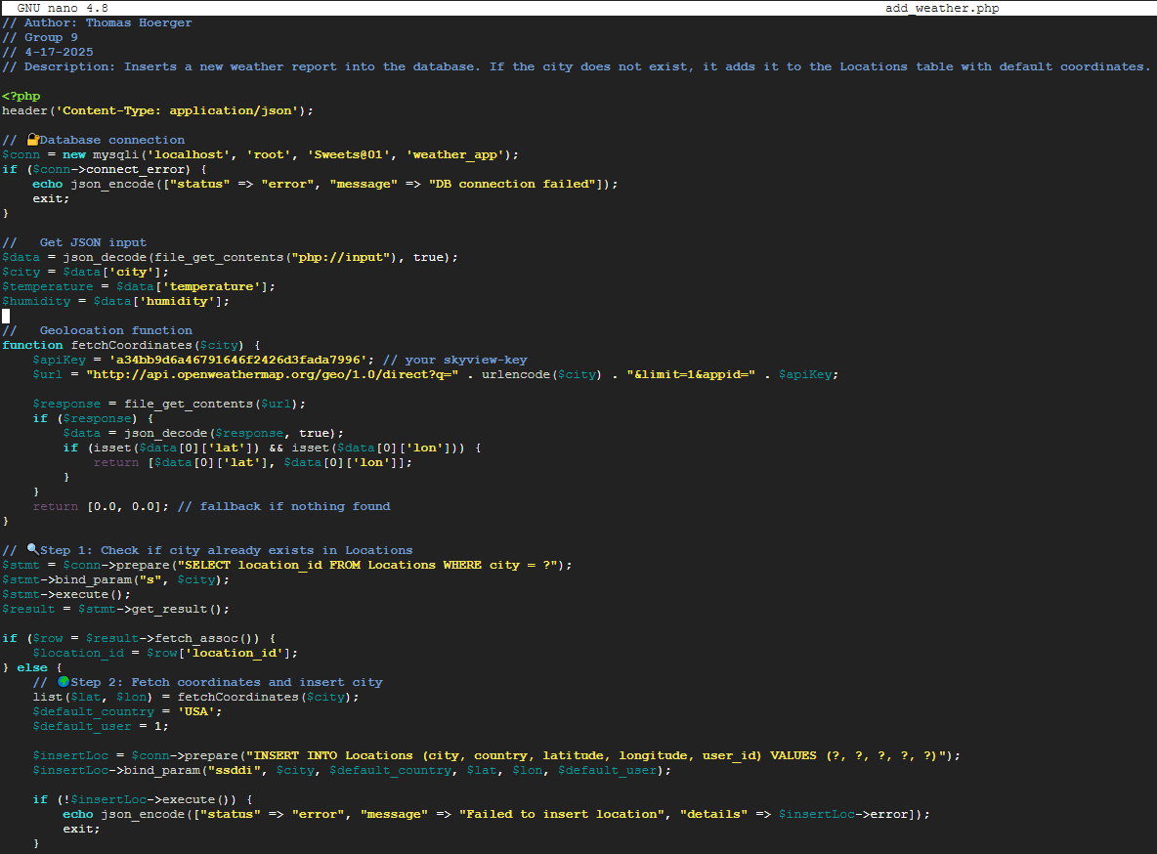
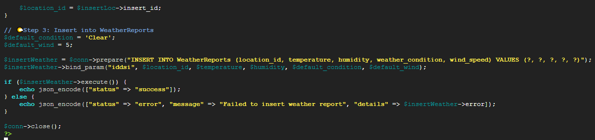
add_weather.php: Adds data to the database.

Slide 7
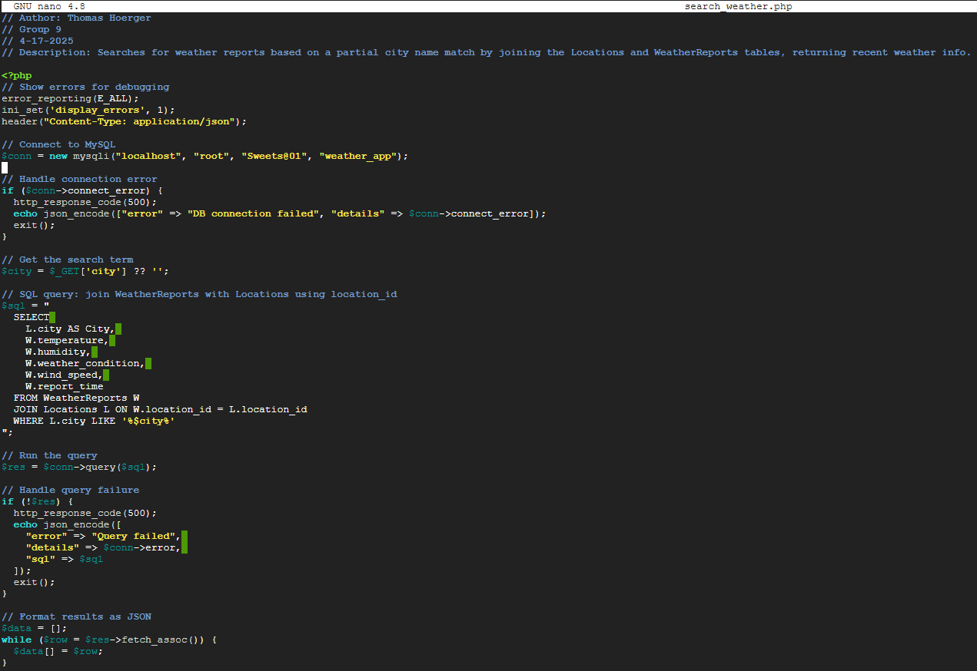
search_weather.php: Retrieves weather by city.

Slide 8
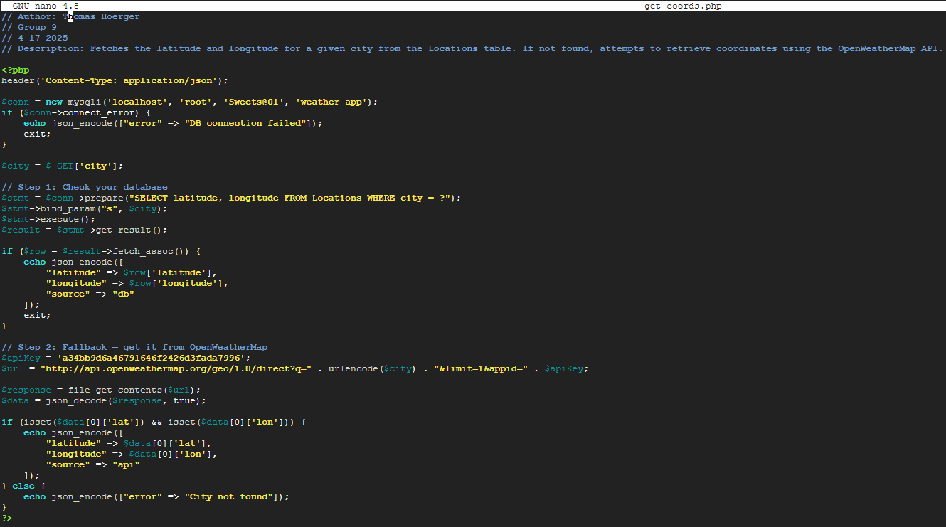
get_coords.php: Zooms map to city location (with fallback to OpenWeatherMap).

Slide 9
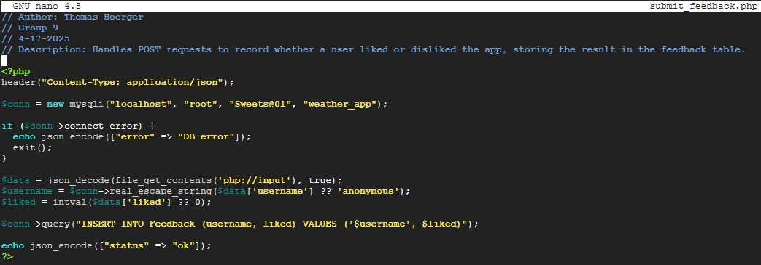
submit_feedback.php: Stores like/dislike values.

Slide 10
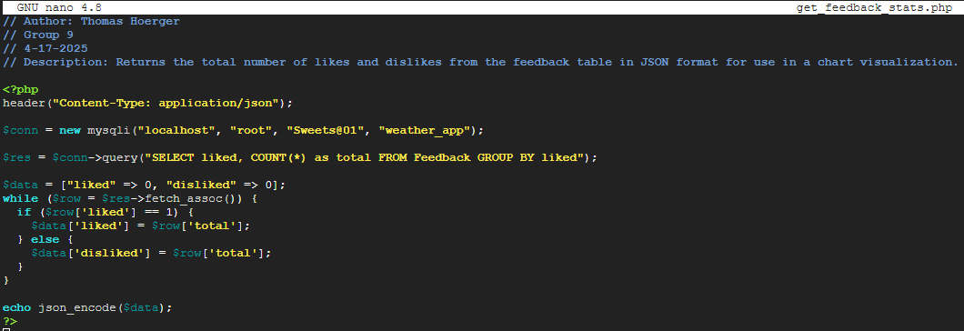
get_feedback_stats.php: Returns feedback data.

Slide 11
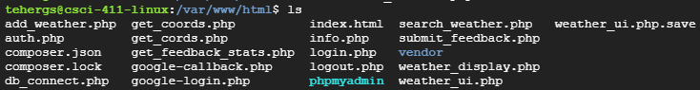
Show VPS Project Directory using ls

Slide 12
Step 5 Implemented 5 screens in the Expo project on my local machine using JavaScript:

Slide 13
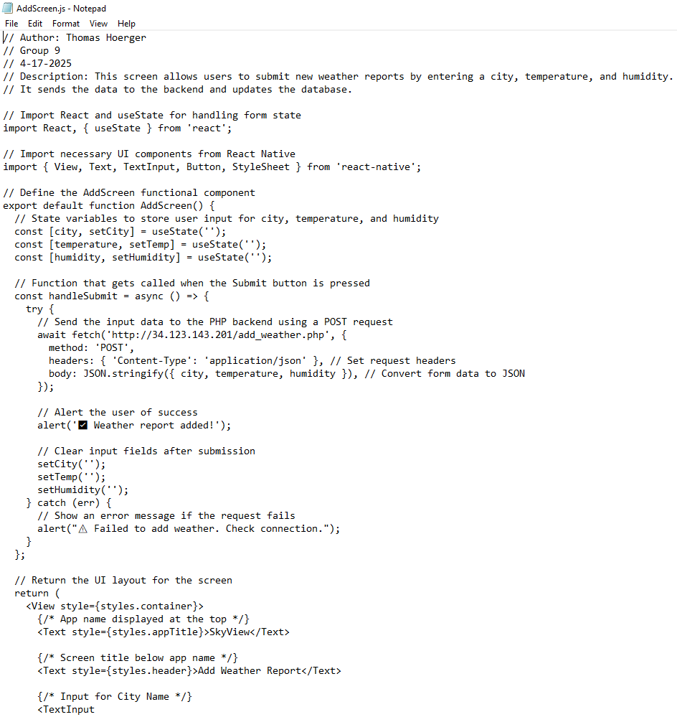
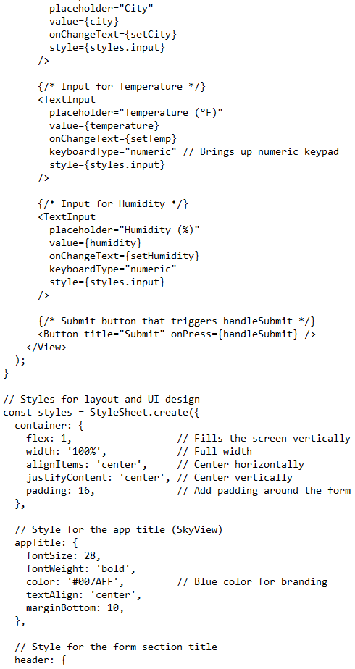
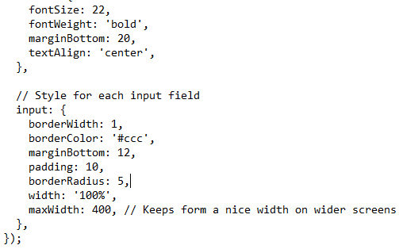
AddScreen.js: Form to submit weather.

Slide 14
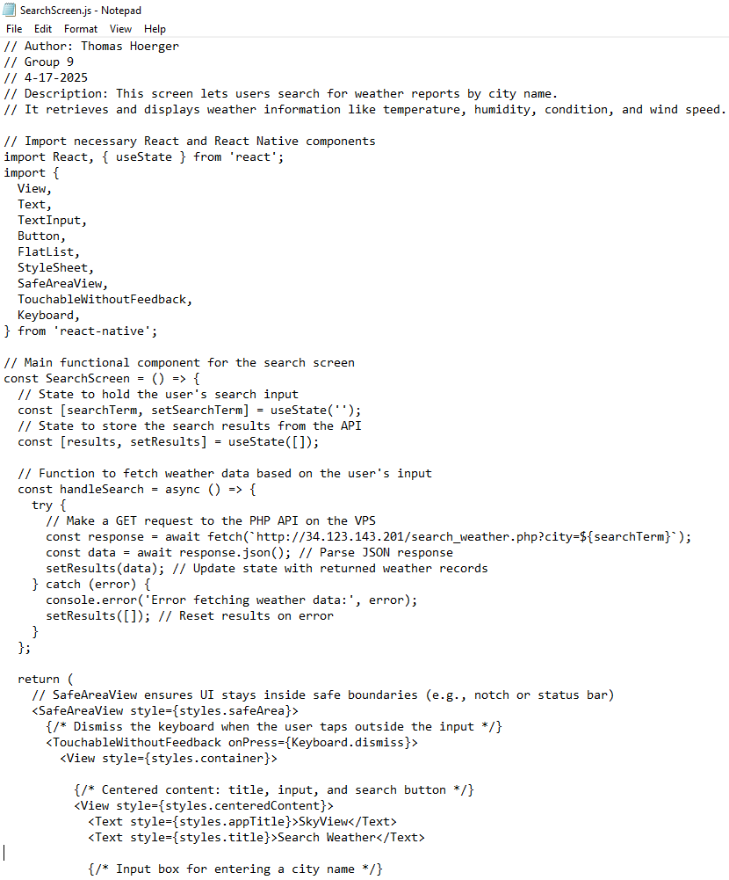
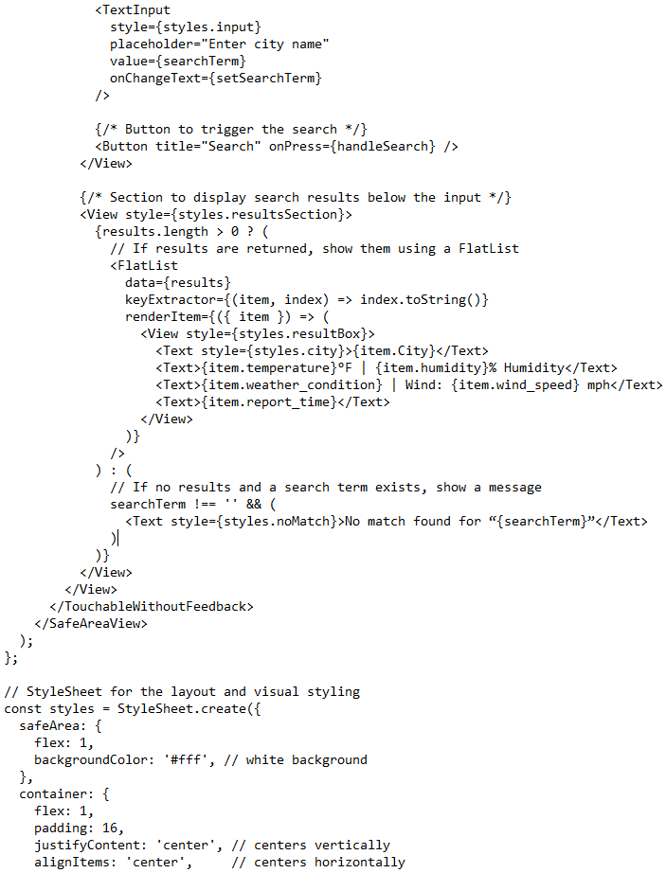
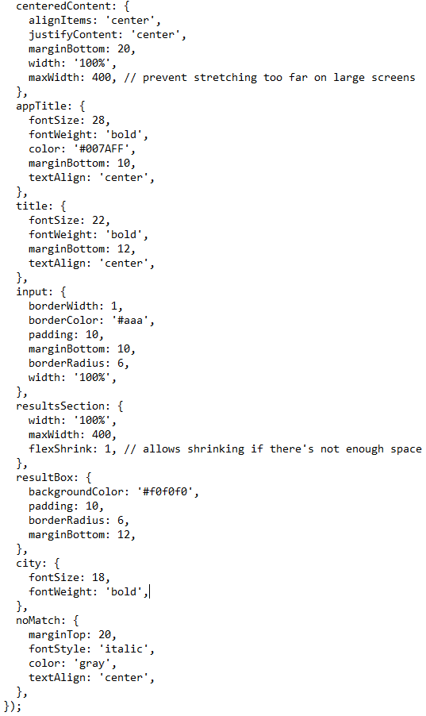
SearchScreen.js: Uses FlatList to show search results.

Slide 15
SearchScreen.js Continued:

Slide 16
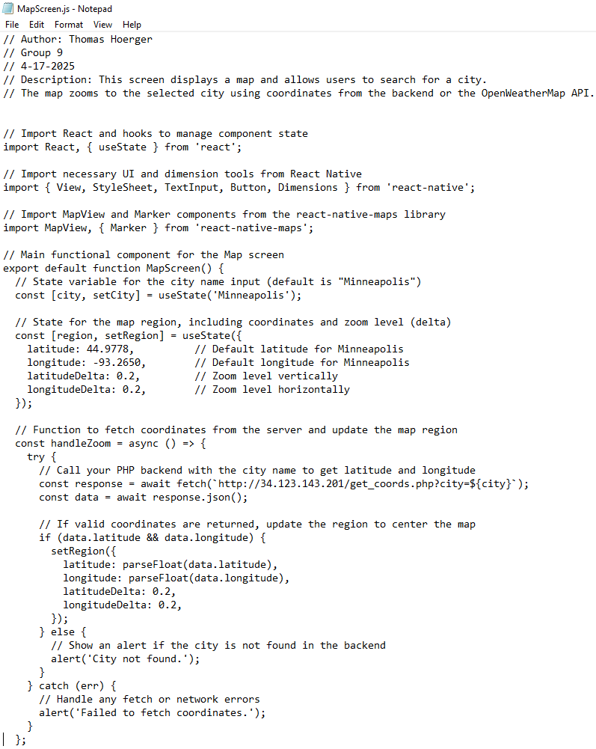
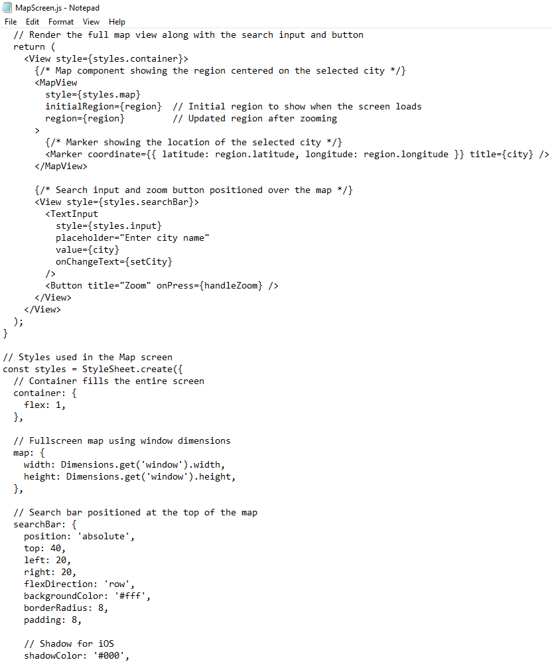
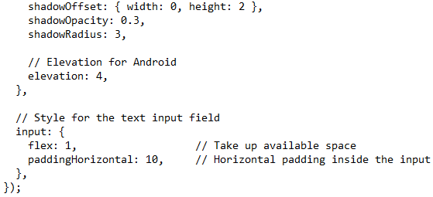
MapScreen.js: Zoom to coordinates using react-native-maps.

Slide 17
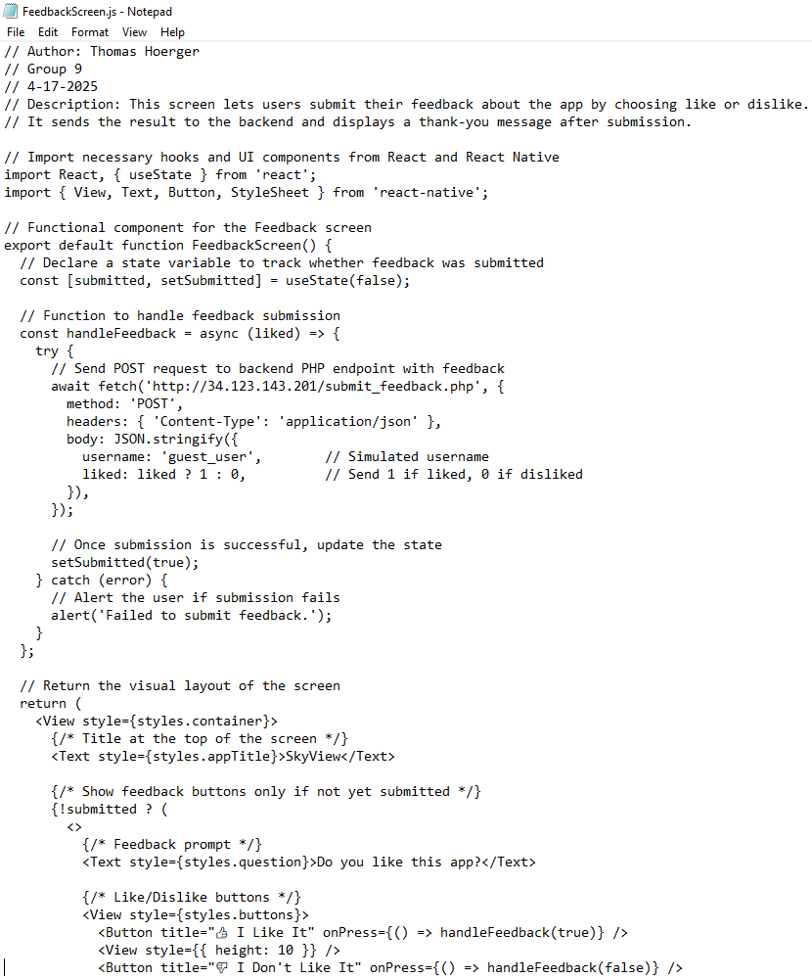
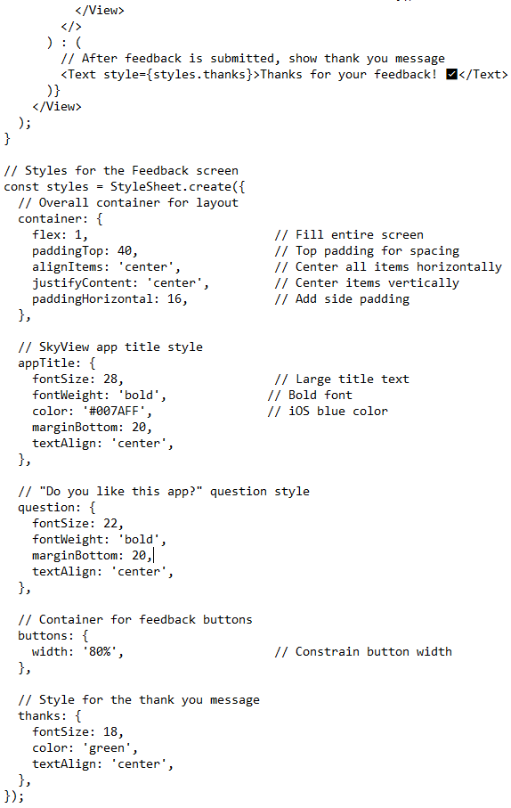
FeedbackScreen.js: Like/dislike UI and submits.

Slide 18
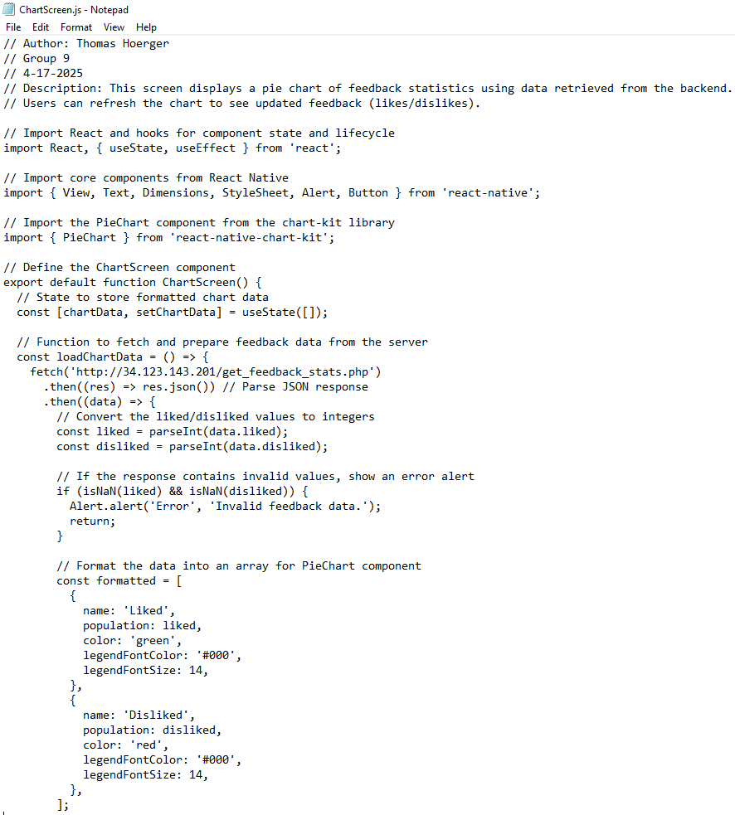
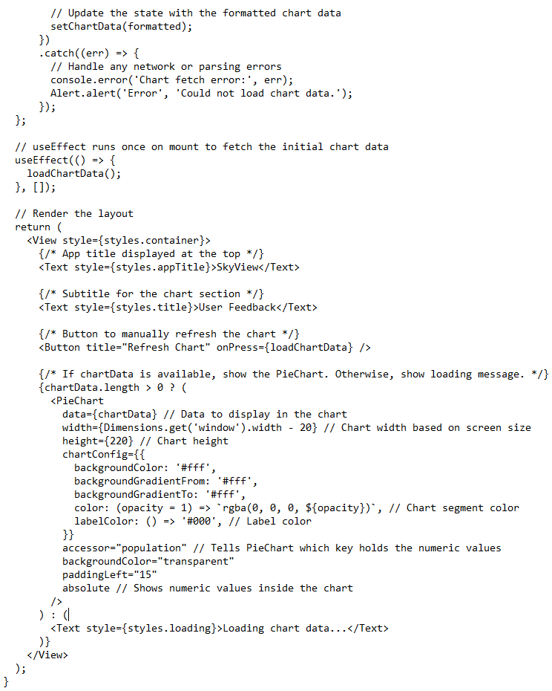
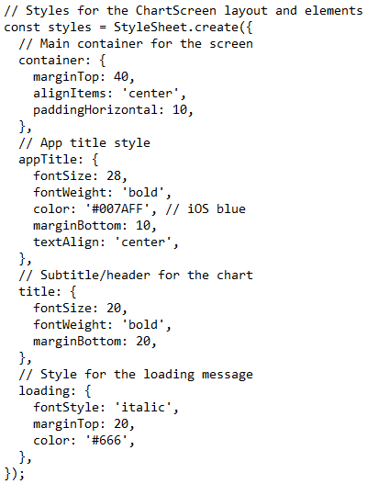
ChartScreen.js: Pie chart using react-native-chart-kit.

Slide 19
Included Features:
• Installed react-native-swiper for navigation.
• Added custom dot and arrow indicators.

Slide 20
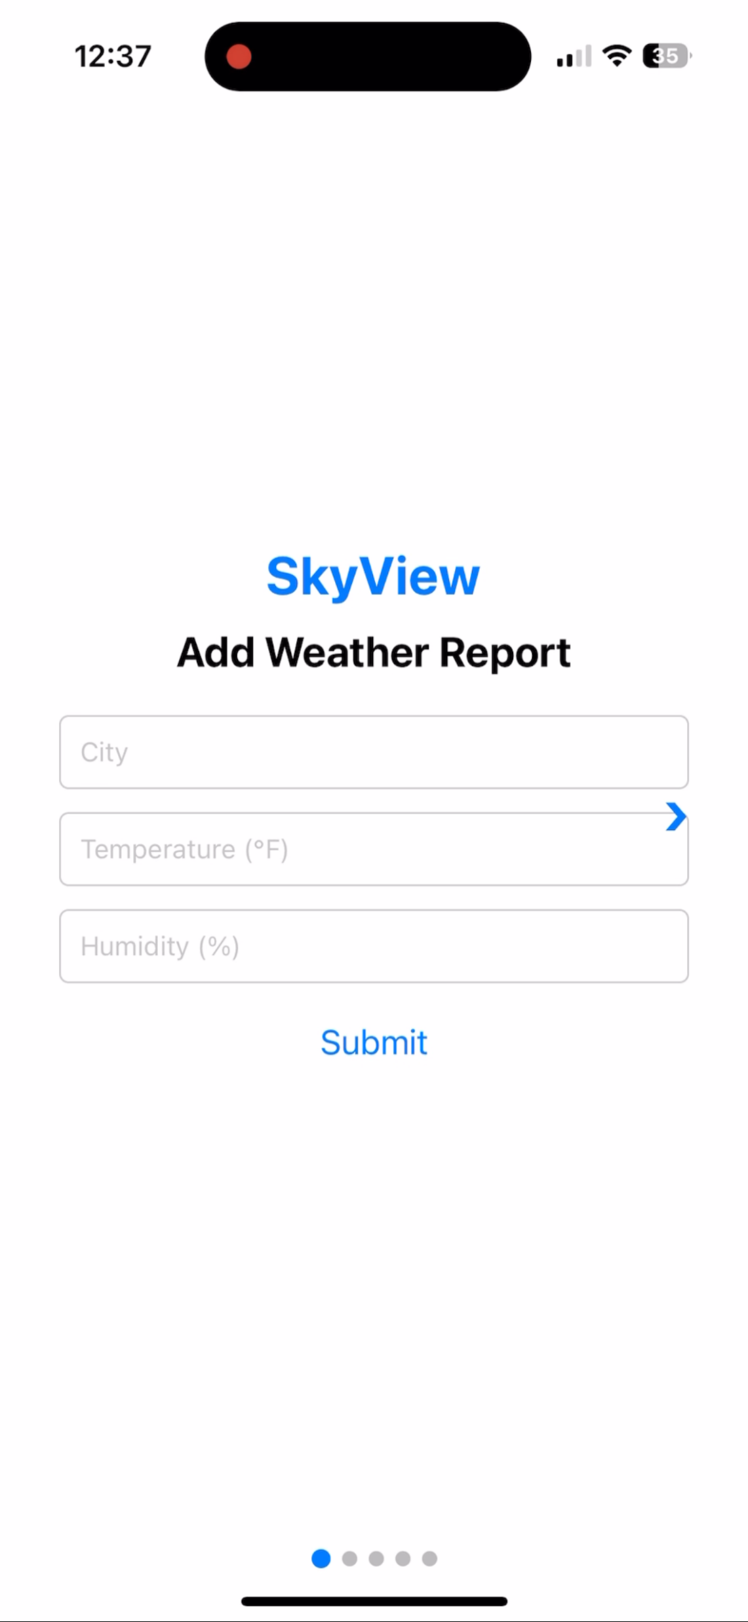
Included Features Continued:
• Implemented add feature so that the user can add to the database via the app.

Slide 21
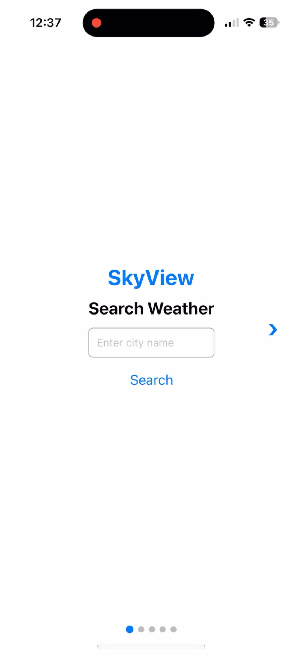
Included Features Continued:
• Added search so that the user can display weather reports from the searched city.

Slide 22
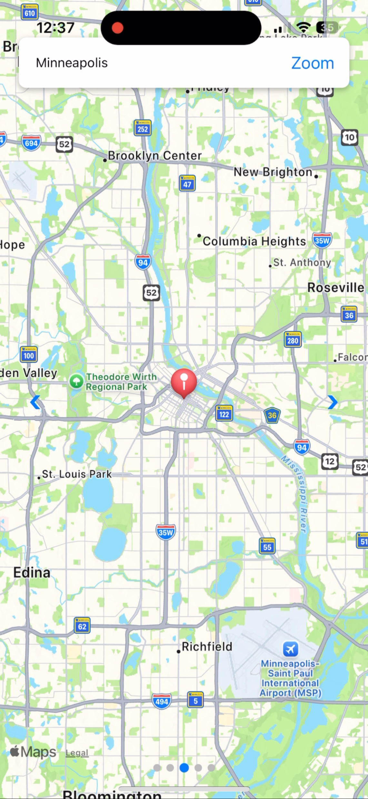
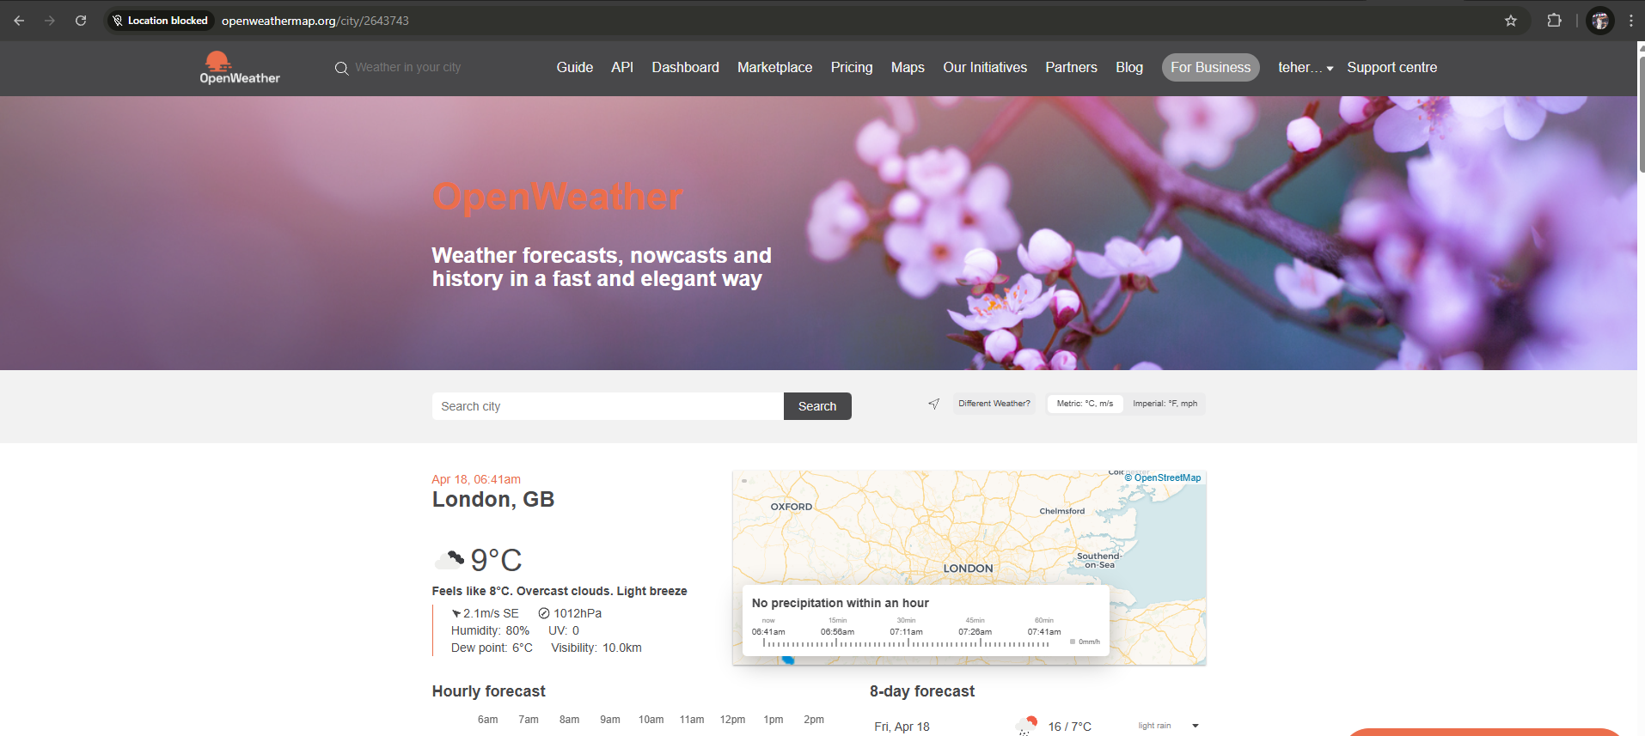
Included Features Continued:
• Added map feature so that the user can search a city and display it on a map.
• Integrated OpenWeatherMap API (Geo API) into get_coords.php. So, if the city isn’t in the database, script fetches coordinates live from API

Slide 23
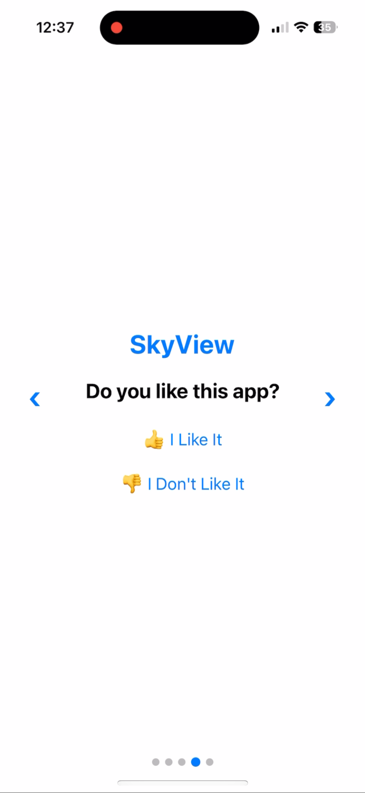
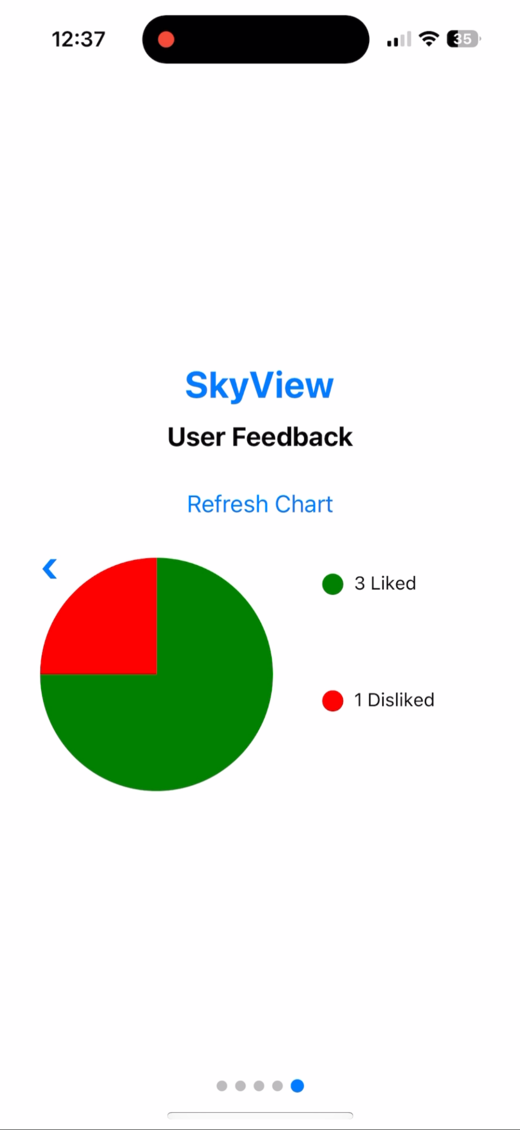
Included Features Continued:
Feedback + Chart System
• Users select like/dislike and submit.
• Chart displays live data from database using a refresh button.

Slide 24
Included Features Continued:
Ensure Mobile Responsiveness
• Used responsive styles to support both mobile and laptop views.
• Components such as maps, charts, and form fields scale based on screen size.

Slide 25
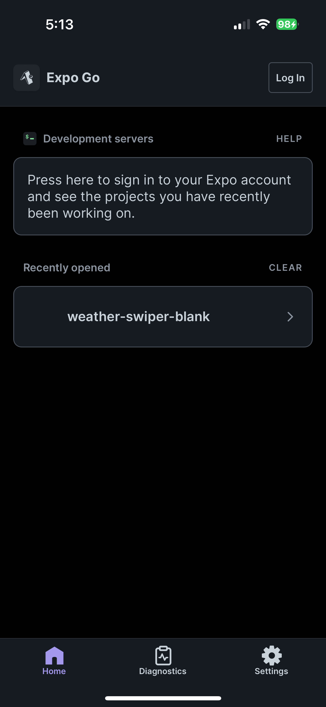
Final Step: Install Expo Go app and scan QR code to use app.

Slide 26
Summary:
In this project, I successfully designed and implemented a full-stack weather tracking application — SkyView — that is responsive, user-friendly, and powered by live data.
🌦️ Users can add and search weather reports for any city
🗺️ Interactive map view with dynamic geolocation support
📊 Feedback system with real-time pie chart visualization
📱 Fully functional across mobile and desktop platforms
The app is hosted on a live VPS and demonstrates real-time database integration, dynamic UI with React Native, and external API usage.
This project showcases my ability to combine design, frontend development, backend integration, and deployment into one cohesive and functional experience.

